Slide 1

Next Hikes Internship Project Telco Data Analysis
By
HARSHADA PATIL

Slide 2
Telco Data Analysis
Projects Contents
Top Handset and Handset Manufacturing Analysis
Top 10 Handset type & Top 3 Manufacturer
Interpretation and Recommendations
User Behaviour Analysis
Result of User Behaviour Data Frame
Non-Graphical Univariate Analysis
Graphical Univariate Analysis
Bivariate Analysis by Data Usage Category
Correlation Matrix
Decile Analysis for Total Duration
Principal Component Analysis (PCA) Results
Loadings in Principal Component Analysis (PCA)

Slide 3
Top Handset and Handset Manufacturing Analysis
1. From given data top 10 Handsets are :
Huawei B528S-23A,Apple iPhone 6S (A1688), Apple iPhone 6 (A1586) are more preferred
Huawei B528S-23A is the most popular handset,.
Undefined handsets require further investigation.
2. Top 3 Handset Manufacturers :
Apple, Samsung and Huawei. is the leading manufacturer
3. Top 5 Handsets per Manufacturer :
Apple iPhones like iPhone 6S, iPhone 6, and iPhone 7 are popular.
Huawei B528S-23A is the top handset for Huawei.
Samsung Galaxy S8, Galaxy A5, and Galaxy J5 are among the preferred Samsung models.

Slide 4
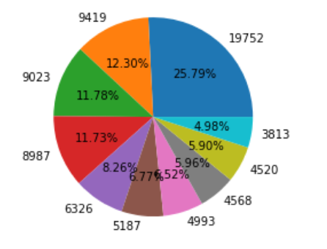
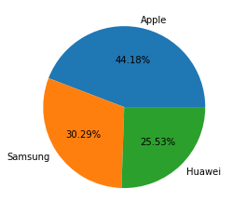
Top 10 Handset type & Top 3 Manufacturer
Top 10 Handset Type
Top 3 Handset Manufacturer
From above pie diagram we can easily visualize top manufacturer and Handset Type

Slide 5
Interpretation and Recommendations
Promote Popular Handsets :
Huawei, Apple and Samsung are the top 3 manufacturer in the current market
From top 10 handset type we conclude, these are the popular devices in current market
so the marketing team should focus on promoting these brands and collaborate with apple Samsung and Huawei manufacturer to achieve target
Showcase the features and benefits to attract more customers.
Establish partnerships with Apple, Samsung, and Huawei to leverage their market dominance.
Conduct investigation to find out the nature of undefined handsets.

Slide 6
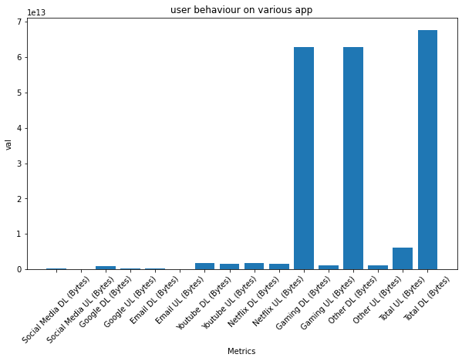
User Behaviour Analysis
User behavior analytics (UBA) is the tracking, collecting and assessing of user data and activities using monitoring systems.
Data Aggregation
app data usage indivisually:
from above data we can conclude that users are spending much of data on watching Netflix, Gaming, and downloading data

Slide 7
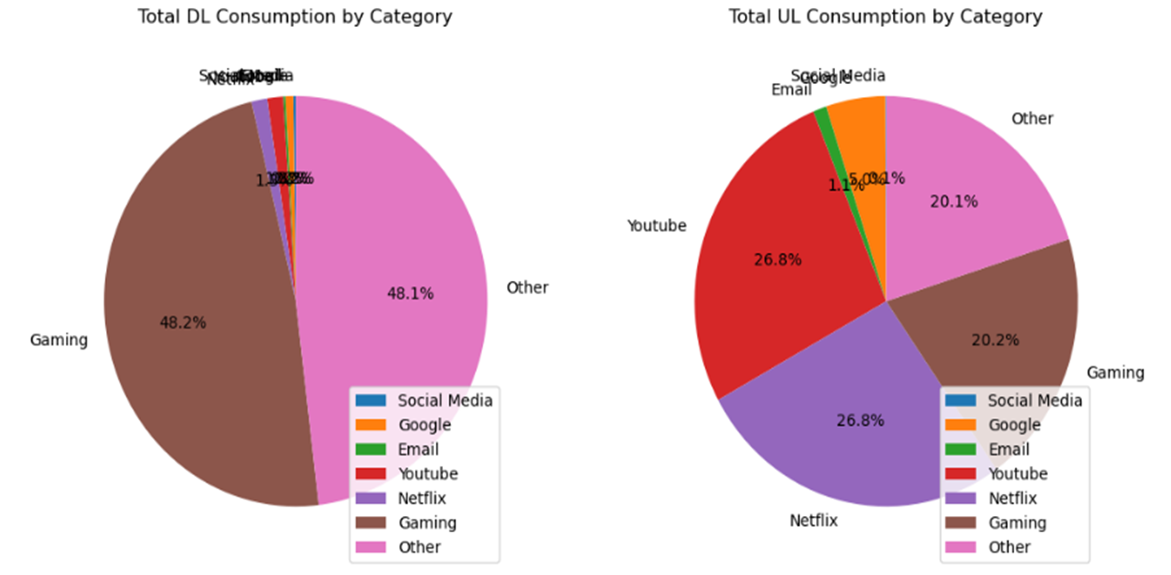
Result of User Behaviour Data Frame
Overview of aggregated metrics
Data Usage
App Specific Data Usage
Conclusion :
1.User behaviour analysis provides valuable insights into data usage patterns.
2.It helps identify popular applications and user preferences

Slide 8
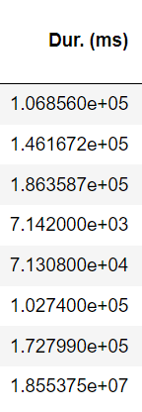
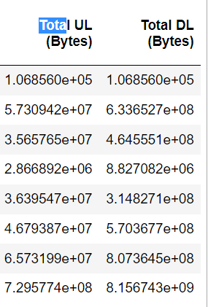
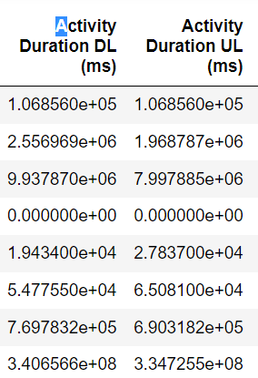

Non-Graphical Univariate Analysis

Slide 9
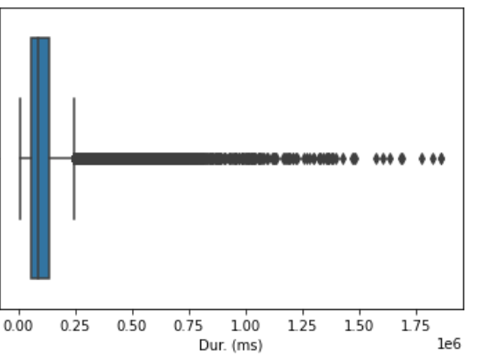
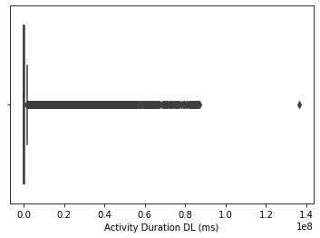

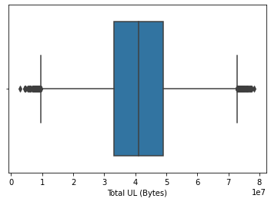
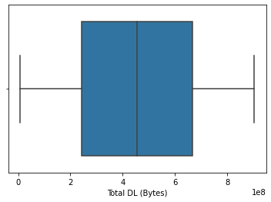
Graphical Univariate Analysis
Boxplot shows I univariate analysis

Slide 10
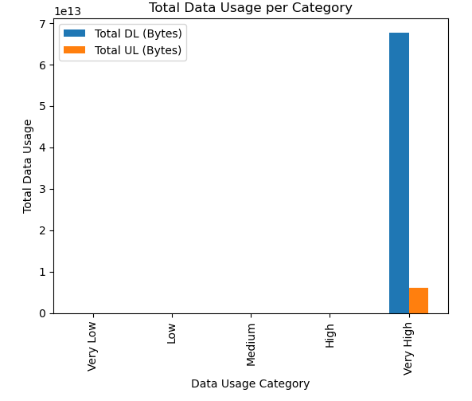
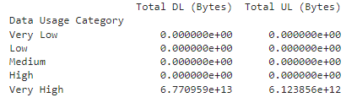
Bivariate Analysis by Data Usage Category
Variables under analysis: "Total DL (Bytes)" and "Total UL (Bytes)".
Grouping by "Data Usage Category".
Output interpretation for each category.

Slide 11
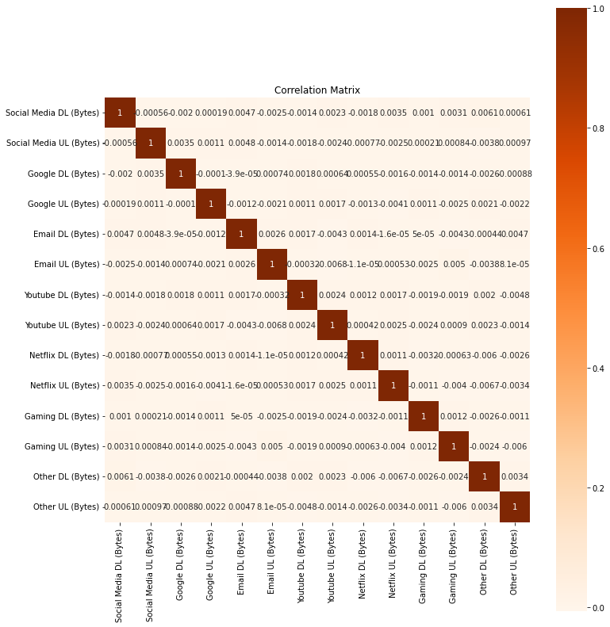
Correlation Matrix
Explanation of correlation values and their range.
Diagonal elements: Correlation of each variable with itself.
Off-diagonal elements: Correlations between pairs of variables.

Slide 12
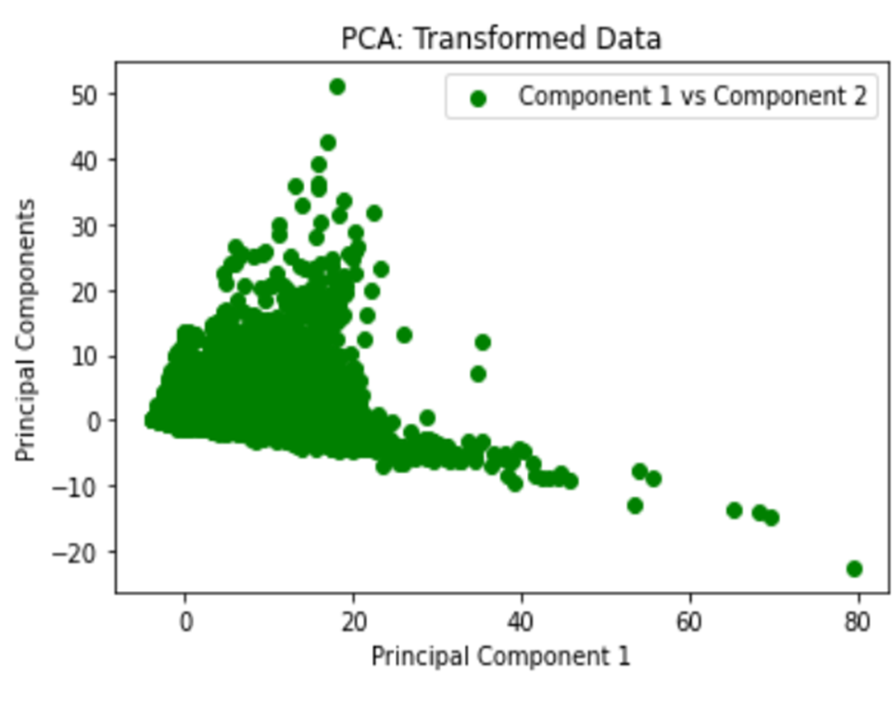
[0.56738611, 0.09060235])
Principal Component Analysis (PCA) Results
0.56738611
Explanation of PC1 and PC2.
PC1: Scores 0.56738611
PC2: Scores 0.09060235
Variance explained by PC1 and PC2
Variance Explained by PC1:0.7878322882996247
Variance Explained by PC2:0.21104689943185198
Cumulative variance explained by PC1 and PC2

Slide 13
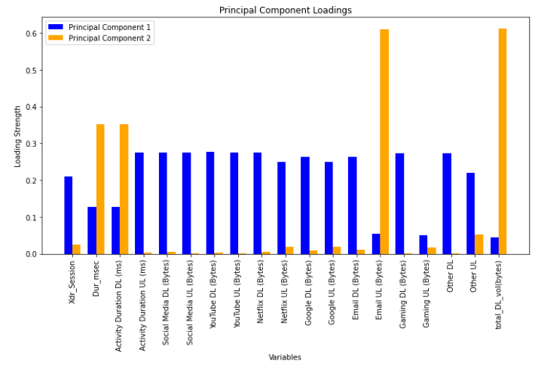
Loadings in Principal Component Analysis (PCA)
Loadings for PC1 :
- Variables with small loadings (close to zero)
- Variables with high positive loadings: "Gaming DL" and "Other DL"
Loadings for PC2 :
- Variables with small loadings (close to zero)
- Variables with high loadings: "Gaming DL" and "Other DL“
Implications of the loadings

Slide 14
Thank You

